Slide 1
Lab 2: Exploring Data with Graphical Displays and Numerical Summaries
Pre Lab
Shan Zhong

Slide 2
Concepts Needed for Lab 2
Types of Variables:
Discrete Quantitative – results are numbers that represent a count (“the number of …”).
Continuous Quantitative – results are numbers that represent a measurement.
Categorical – numbers that are not counts or measurements and anything that is not a number.

Slide 3


Slide 4
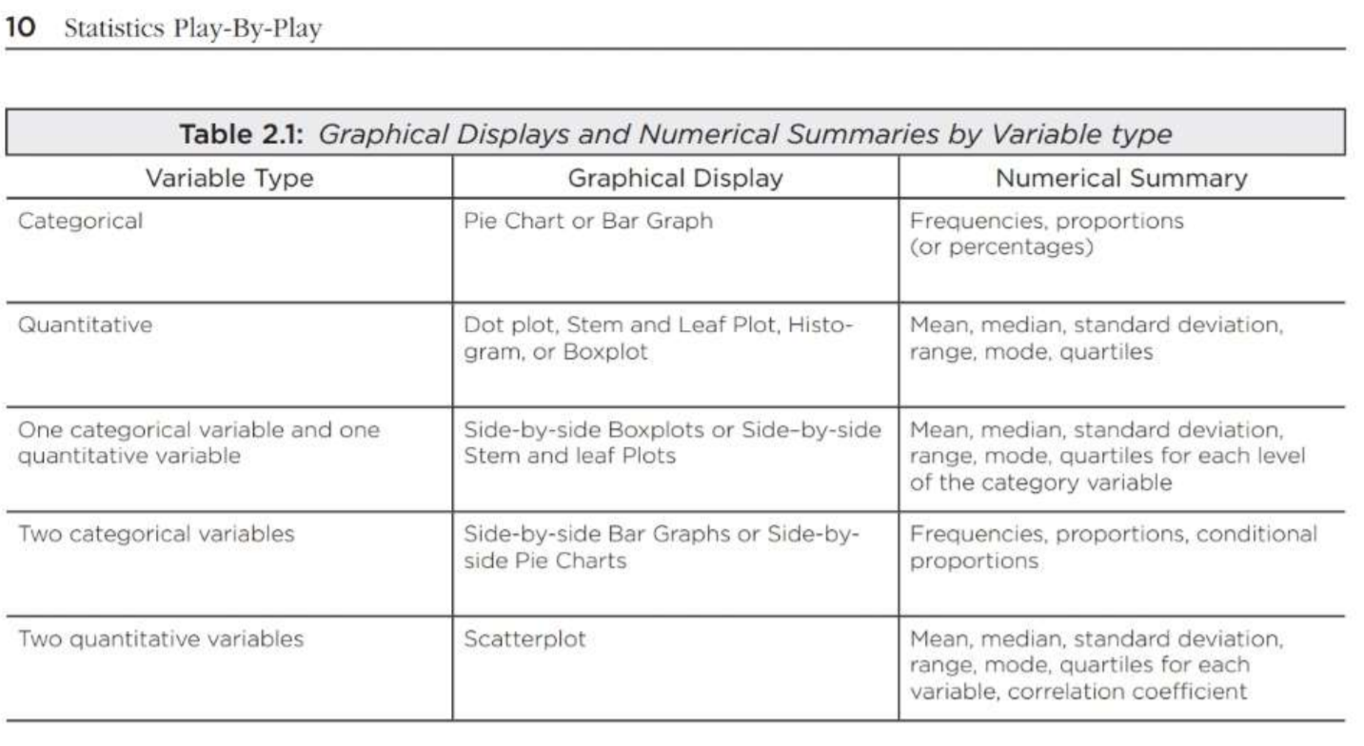
Graphical Displays and Numerical Summaries:
To determine which graphical displays and numerical summaries are appropriate for a variable reference Table 2.1 on page 10.

